Slide 1

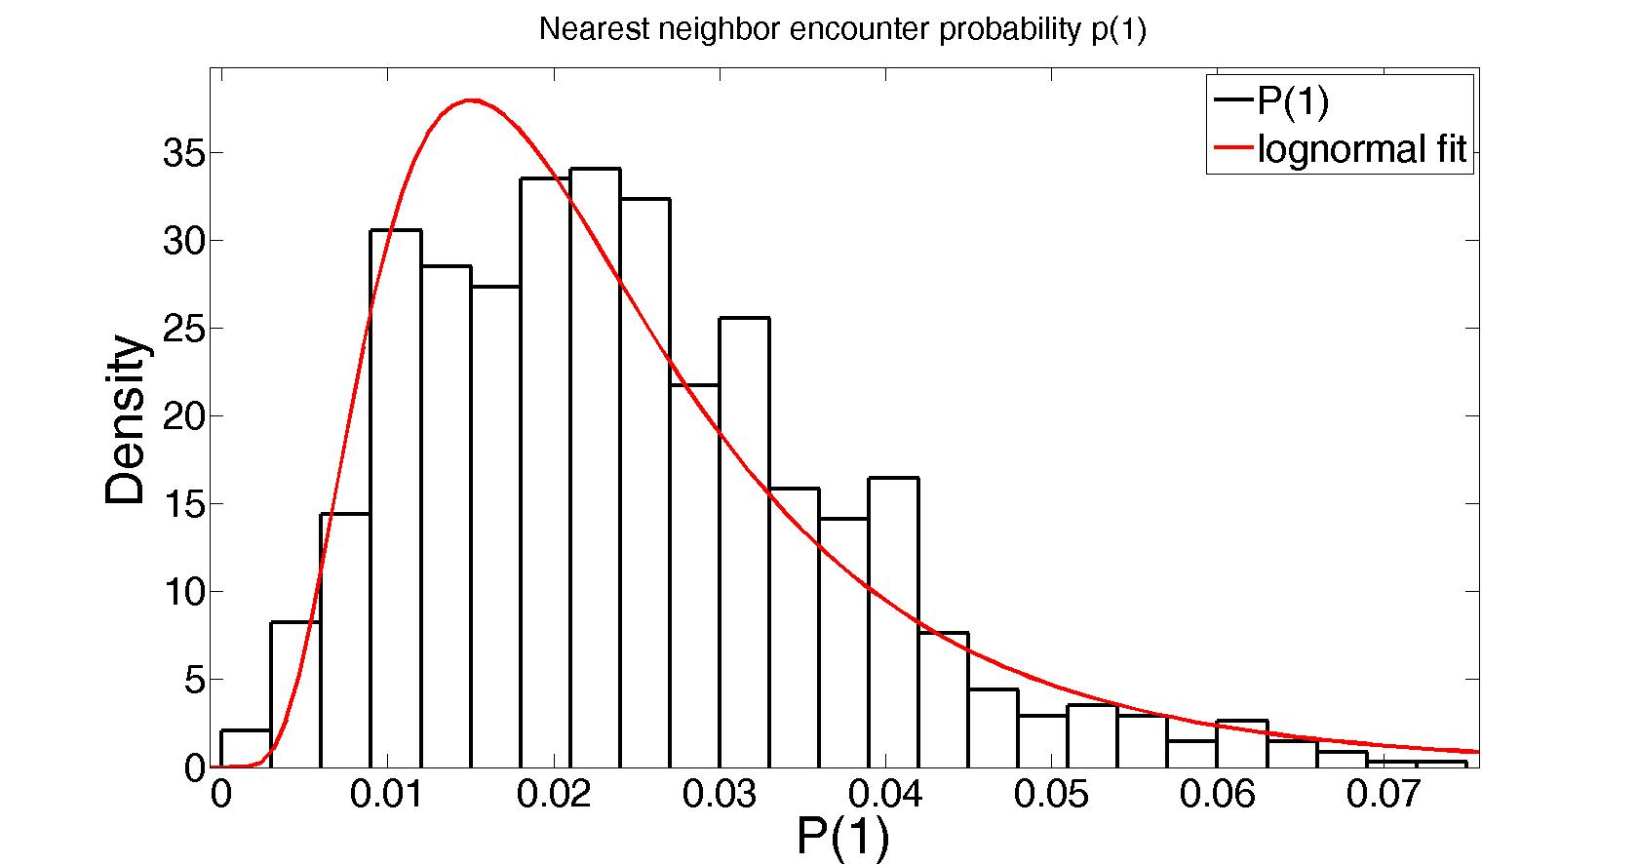
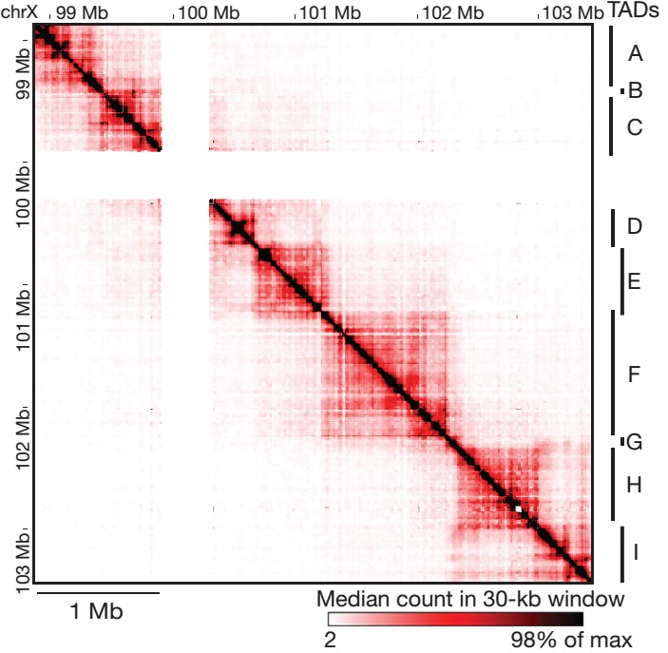
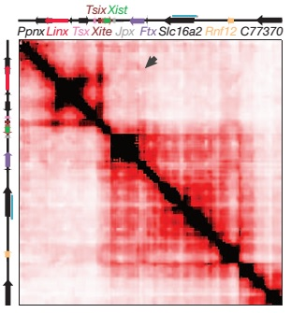
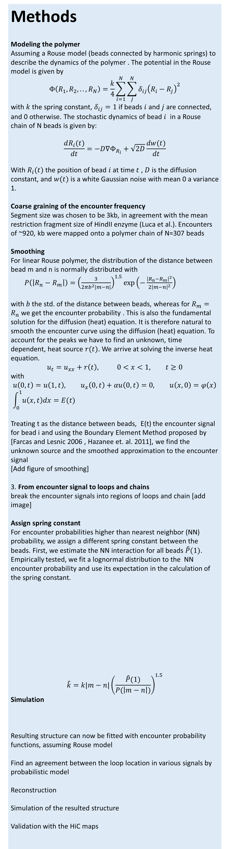
Reconstruction of the X-inactivation center structure using HiC encounter frequency maps
Ofir Shukron, David Holcman,
Departement de Biologie, Ecole Normale Superieure, 46 rue d’Ulm, 75005, Paris, France
Goal Reconstruct the local polymer architecture using HiC encounter frequency maps. Study the dynamic properties of the resulting structure, such as the encounter time distribution and Mean First encounter time (MFET) between different parts of a polymer.
Significance Providing a tool to transform static HiC encounter map to an average polymer structure, which captures salient features in the chromosome microstructure, allowing analysis and simulation of the dynamics of a cross-linked polymer in various scenarios.
Background:
HiC experiment simultaneously captures millions of looping events of the chromosome. HiC steps are presented in figure 1 A.
Analysis of the HiC encounter frequencies in mouse embryonic stem cells reveals the presence of stable Topologically Associating Domains (TAD) , in the 4.5Mb region of the X inactivation center figure 1B. However, the actual architecture in a specific stage is unknown
The data:
we use a subset of ~1Mb region of the X-chromosome around the X- inactivation center , provided by G.Luca et. Al.
Methods
Modeling the polymer
Assuming a Rouse model (beads connected by harmonic springs) to describe the dynamics of the polymer . The potential in the Rouse model is given by $$Φ\left(R_{1},R_{2},..,R_{N}\right)=\frac{k}{4}\sum_{i=1}^{N}{\sum_{j}^{N}{{δ_{ij}\left(R_{i}−R_{j}\right)}^{2}}}$$ with $k$ the spring constant, $δ_{ij}=1$ if beads $i$ and $j$ are connected, and 0 otherwise. The stochastic dynamics of bead $i$ in a Rouse chain of N beads is given by:
$$\frac{dR_{i}(t)}{dt}=−D∇Φ_{R_{i}}+\sqrt{2D}\frac{dw(t)}{dt}$$
With $R_{i}(t)$ the position of bead $i$ at time $t$ , $D$ is the diffusion constant, and $w(t)$ is a white Gaussian noise with mean 0 a variance 1.
Coarse graining of the encounter frequency Segment size was chosen to be 3kb, in agreement with the mean restriction fragment size of HindII enzyme (Luca et al.). Encounters of ~920, kb were mapped onto a polymer chain of N=307 beads
Smoothing For linear Rouse polymer, the distribution of the distance between bead m and n is normally distributed with $P\left(\left|R_{n}−R_{m}\right|\right)={\left(\frac{3}{2πb^{2}|m−n|}\right)}^{1.5}exp⁡\left(−\frac{{\left|R_{n}−R_{m}\right|}^{2}}{2{\left|m−n\right|}^{2}}\right)$ with $b$the std. of the distance between beads, whereas for $R_{m}=R_{n}$ we get the encounter probability . This is also the fundamental solution for the diffusion (heat) equation. It is therefore natural to smooth the encounter curve using the diffusion (heat) equation. To account for the peaks we have to find an unknown, time dependent, heat source $r(t)$. We arrive at solving the inverse heat equation.
$$u_{t}=u_{xx}+r\left(t\right), 0<x<1, t≥0$$
with
$$u\left(0,t\right)=u\left(1,t\right), u_{x}\left(0,t\right)+αu\left(0,t\right)=0, u\left(x,0\right)=φ\left(x\right) \\ \int_{0}^{1}{u\left(x,t\right)dx=E(t)}$$
Treating t as the distance between beads, E(t) the encounter signal for bead i and using the Boundary Element Method proposed by [Farcas and Lesnic 2006 , Hazanee et. al. 2011], we find the unknown source and the smoothed approximation to the encounter signal
[Add figure of smoothing]
3. From encounter signal to loops and chains
break the encounter signals into regions of loops and chain [add image]
Assign spring constant
For encounter probabilities higher than nearest neighbor (NN) probability, we assign a different spring constant between the beads. First, we estimate the NN interaction for all beads $\hat{P}(1)$. Empirically tested, we fit a lognormal distribution to the NN encounter probability and use its expectation in the calculation of the spring constant.
$$\hat{k}=k|m−n|{\left(\frac{\hat{P}(1)}{P(\left|m−n\right|)}\right)}^{1.5}$$ Simulation
Resulting structure can now be fitted with encounter probability functions, assuming Rouse model
Find an agreement between the loop location in various signals by probabilistic model
Reconstruction
Simulation of the resulted structure
Validation with the HiC maps
Results:
In synthetic example, we see accurate reconstruction.
Figure 1
A
1. Cross-linking the polymer using formaldehyde
2. HindIII digestion
Polymer cross-links
3. Ligation
4. Reverse cross-linking, and PCR
B
Nora et. al 2012

